Slide 1
10 MW BIOMASS POWER STATION CONSTRUCTION PROJECT
YAGOTYN CITY, KIEV REGION STAGE 1 - 2.5 MW
"NVK "COGENERATION" LLC

Slide 2
PROJECT SUMMARY
The main idea is the construction of a 10 MW biomass power plant in 4 stages, based in the “Budplastic” factory in Yagotyn city, Kyiv region.
It is planned to construct a power station in Yagotyn city, Kyiv region (Selhoztehniki str., 5).
It is planned to install two condensing steam turbines with an electric generator and to equip the exhaust steam condensation system with a turbine to produce electricity.
It is possible to use wood chips, wood pellets, granulated waste from sunflower, pellets from agricultural products wastes, peat moss.

Slide 3
Importance of the location
Raw materials base
Railway
An analysis of the adjacent territory of the TPP showed that the main local biomass could be: wood chips, granulated waste from sunflower, rapeseed and oilseed crops, as well as peat moss. The surrounding areas are used to grow various grain crops. There are free areas for growing energy willow for the production of wood chips as well.
The nearest railway Yagotyn station is 323005 at a distance of 1.2 km from the settlement.
Power supply
The territory of «Budplastic» is 4.4 hectares and is conveniently located: the distance to the nearest 10 kV substation is less than 1 km. The territory is 14500 m2 of premises with high ceilings.
Highway
The territory of "Budplastic" is located within the boundaries of the Yagotyn city. It is possible to deliver biomass by trucks. The territory inside the enterprise allows to provide convenient conditions for unloading cars. A large logistic center Roshen in nearby, it facilitates the search for vehicles to deliver biomass.

Slide 4
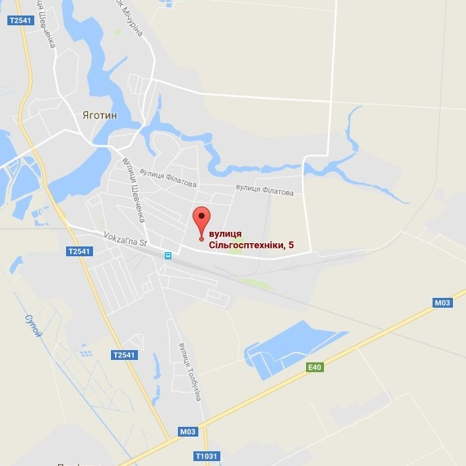
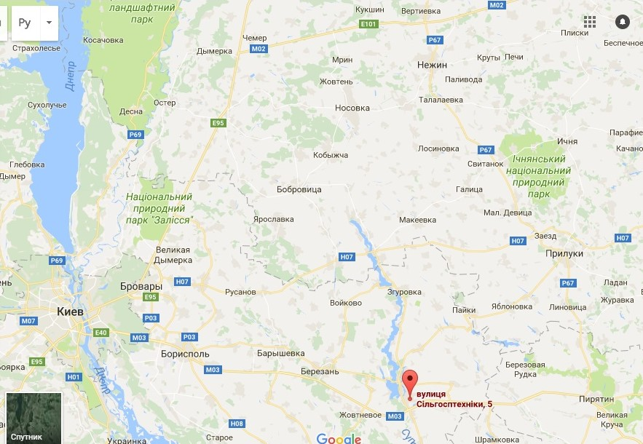

Slide 5
Benefits and prospects
DEVELOPMENT
SECTOR
PROSPECTS
THE ENTRY COST
“THE GREEN TARIFF”
PUBLIC SPHERE
The experience of building similar stations indicates the cost of 1kW of installed capacity - $ 3,500.
State supports the sector due to “The Green Tariff” and tax benefits. The minimum "Green Tariff" is fixed to 2020 and is 13.6 euro cents / kWh.
According to the Decision of the Energy Community Ministerial Council, Ukraine has taken an obligation to reach 11% of energy production from renewable sources by 2020 (6% as for today).
Ukraine has sufficient amounts of biomass; its occupies the 7th place in Europe in terms of its volumes. The share of plantations will grow significantly in the next 10 years.
4
5
The Green Tariff for all types of power plants that produce electricity from alternative sources will decrease when compared to the level of 2016
Imported equipment is free of customs duty and is exempted from VAT, if the relevant equipment is not being produced in Ukraine
1
6
Preferential tariff by 2030
The rental rate for the land that is used for renewable energy facilities is reduced to 3% of the land value, compared to the standard 12 % rate
2
Linked tariff to the EUR
3
Monthly regulation of “The Green Tariff" by NKREKP

Slide 6
The key project parameters Stage 1 of 4, 2.5 MW of 10 MW
The main equipment of the TTP is steam boilers and electrical energy generators. Boilers produced by the Ukrainian Monastyrische plant will be used. These boilers will be structurally upgraded to obtain the required power parameters and to improve their thermal efficiency. These improvements are patented in Ukraine. These boilers can effectively work on various types of solid fuel.
Overall TTP data
Capacity | MW | 2.5
Construction period | months | 12-13
Staff | person | 46
“The Green Tariff” | EUR/kWh | 0,136
Operation time | hours/year | 8 100,00
Investments | USD | 2 100 000
Technological cycle of the station: unloading biomass, burning biomass in boilers with steam and electrical energy generation, generation of electricity by a generator due to steam turbine rotation.
The estimated cost of similar projects based on new equipment is about 2000-3000 USD per kW, the cost of our project is about 800 USD per kW.

Slide 7
The results of the TTP construction project Stage 1 of 4 – 2.5 MW of 10 MW
Name of indicator | Period
 | 2018 | 2019 | Production 3 | Production 4
Profit (excluding VAT) | 0 | 1 416 000,00 | 1 416 000,00 | 1 416 000,00
VAT | 0 | 236 000,00 | 236 000,00 | 236 000,00
Production cost | -140 000,00 | 730 000,00 | 730 000,00 | 730 000,00
EBITDA | 0 | 1 820 000,00 | 1 560 000,00 | 1 560 000,00
Amortization | 0 | 80 000,00 | 80 000,00 | 80 000,00
Income tax | 0 | 50 000,00 | 272 000,00 | 272 000,00
Net Profit |  | 1 712 000,00 | 1 233 000,00 | 1 233 000,00

